Slide 1
Introduction
What shall become of the EA Field and our Profession if we fail to aggressively fund and regularly publish meaningful applied research? This is something each of us should carefully consider. We must not lag in our responsibility to foster and protect an earnest collaboration between researchers, vendors and purchasers. Absent this collaboration we will wander from our true course and fall short of our full potential.
Background on the Study and Using the Slide deck
In March 2011 the Employee Assistance Research Foundation (EARF) announced that the National Behavioral Consortium (NBC) was selected to receive a $40,000 grant.
Utilizing this grant the National Behavioral Consortium (NBC) conducted a multinational survey (2012) that collected key Employee Assistance Program (EAP) metrics on External EAP Vendors. The survey data were collected from the US, Canada and 10 additional countries and included over 146 Million covered lives and 29,000 client companies.
It is common practice in many professions and fields to disseminate comparative information. Absent this vital resource an individual company cannot accurately evaluate their performance against a similar cohort and therefore must rely upon anecdotal information. The findings of this study address this deficiency in the Employee Assistance Program (EAP) field by reporting empirically derived comparative data for external providers of EAP services. During 2012 the National Behavioral Consortium surveyed 82 external EAP vendors primarily located in the United States and Canada.
The study addressed a key question in the EAP Field: What are the basic metrics and characteristics that describe External EAP Vendors and their provision of services. Eight categories of information were examined in this study: Corporate structure, Staffing, Client Companies Profile, Utilization Metrics, Survey tools, Business Management, Business Development and Forecasting the Future of EAP. The survey instrument was designed specifically for External EA Vendors and included 44 items and 157 unique data points.
The participants in the study were contacted using two sampling approaches. The first approach employed a targeted sampling strategy intended to solicit participation from the largest external EAP vendors located in the US (defined by the authors as having greater than 2 million covered lives across all clients) and in Canada (defined as having greater than 1 million covered lives across all clients). The second approach utilized a snowball “convenience” sampling method to invite participation from an unknown much larger group of vendors.

Slide 2
Slide Deck Index
The idea of an NBC EA Vendor slide deck was conceived early in the research process. The co-authors viewed the soon to be published scholarly article: “The National Behavioral Consortium Industry Profile of External EAP Vendors” as a primary source to document our methods and findings. The slide deck includes 133 individual slides. It was created to provide greater ease of access to specific findings. Mark Attridge is to be commended for his work on this companion project.
Slide Index by Topic and Slide Number
Company Profile: Begins on Slide 16
Company Size: Begins on Slide 29
Quality Indicators: Begins on Slide 35
Contract Features: Begins on Slide 39
Counseling Services: Begins on Slide 47
Profile of Users: Begins on Slide 52
Utilization Metrics: Begins on Slide 56
Survey Tools & Outcomes: Begins on Slide 86
Tests of Group Differences by Market Size, Country & Pricing: Begins on Slide 95
Business Management: Begins on Slide 107
Business Development: Begins on Slide 114
The Future of External EAP: Begins on Slide 119
Comments: Begins on Slide 122

Slide 3
Caution About Using the Findings
The participants in the study were contacted using two sampling approaches. The first approach employed a targeted sampling strategy intended to solicit participation from the largest external EAP vendors located in the US (defined by the authors as having greater than 2 million covered lives across all clients) and in Canada (defined as having greater than 1 million covered lives across all clients). The second approach utilized a snowball “convenience” sampling method to invite participation from an unknown much larger group of vendors.
Therefore, the aggregation of this data classifies this study as a convenience survey. Like all surveys, this one has methodological limitations. While this study shines a light in a dark closet it does not turn on all the lights in the house.
The data in the slide deck provides the first empirically derived, publicly available data that describes the key operational characteristics and metrics among external EAP vendors (including large national vendors and smaller, local/regional ones).
Permission to Use the NBC Findings
If you are interested in using the NBC findings please contact Stan Granberry at stan_granberry@yahoo.com.

Slide 4
Acknowledgements
NBC gratefully acknowledges the support and guidance of the EARF Board of Directors and in particular the EARF Grants Committee who provided consultation, advice, and project monitoring throughout the research process. Without Carl Tisone ’s commitment to the field and his leadership in establishing the Employee Assistance Research Foundation (EARF) the National Behavioral Consortium (NBC) study and the attached EA Vendor slide deck would not have happened.
It would be remiss not to recognize the co-authors: Mark Attridge, PhD, Terry Cahill, LCSW, CSADC and Patricia Herlihy, PhD, RN, who devoted a breathtaking amount of time to this research project. Their diligence well exceeded the margins of any reasonable expectations. They labored, persisted and accomplished this responsibility while doing their “real” full time jobs. If you happen to encounter Mark, Terry, or Pat, please offer them your gratitude for their work by “shining a light in a dark closet” and making the EAP field more transparent and open.
Finally, our thanks to the many EAP vendors who agreed to participate in this survey and provide vital data that allowed this study to succeed.
This research project was institutional review board (IRB) approved for following ethical research practices and the data was collected such that the respondent vendor companies remained anonymous. The study was funded by a grant from the Employee Assistance Research Foundation (EARF) www.eapfoundation.com) and it received the endorsements of both EAPA and EASNA organizations.
Stan Granberry, PhD
Principal Investigator, NBC Study of External EAP Vendors
Executive Director, NBC

Slide 5
NATIONAL BEHAVIORAL CONSORTIUM INDUSTRY PROFILE OF EXTERNAL EAP VENDORS
Stanford W. Granberry, PhD
Primary Investigator
Mark Attridge, PhD, MA
Terry Cahill, MSW, LCSW, CSADC
Patricia Herlihy, PhD, RN
Co-Authors
2013
www.nbcgroup.org
© National Behavioral Consortium

Slide 6
Purpose of the Study
The study provides empirically derived benchmarking data for external providers of EAP services.
It addresses many of the key metrics and characteristics that define the external EAP field. It also explores business practices.
This study is the first to provide publicly available benchmarking information based on a large and diverse sample of providers.

Slide 7
Study Sponsor - EARF
This study was supported by a grant from the Employee Assistance Research Foundation (EARF).
The Foundation exists to stimulate innovative, rigorous, and theory-based research activities in the field of EAP.
In September 2010 the Foundation issued its first call for abstracts of original research study proposals to advance the “Understanding the Current State of the EAP Field.”
Many organizations submitted abstracts and a smaller number of applicants were invited to submit full proposals.
In March 2011 the Foundation announced that ISW Limits / University of Leuven (located in Belgium) and the National Behavioral Consortium (located in the United States) were each selected to each receive a $40,000 grant.
Website: www.eapfoundation.org

Slide 8
Study Methodology: Survey Development
New questionnaire created for the study
Panel of Industry Experts
Pilot Tested & Revised
44 Items selected from initial pool of 71

Slide 9
Survey Questions in 8 Categories
Corporate Structure
Staffing
Client Companies
Utilization Metrics
Survey Tools & Outcomes
Business Management
Business Development
Forecasting the Future of EAP
157 total unique
data points if all
44 items fully answered

Slide 10
Study Methodology: Sampling Strategy
STEP 1 = Targeted large carriers in the US and Canada:
Sampling frame based on number of covered lives
US vendors with > 2 million covered lives
Canadian vendors with > 1 million covered lives
STEP 2 = Multi-stage snowball sampling method
email invitations to participate widely distributed
Promotion of study from EAPA, EASNA & others
Two waves in 2012:
1 = May-July = 66 participants
2 = October-November = 16 participants

Slide 11
Study Methodology: Summary of Sample
130 total respondents entered website tool
48 responses rejected as invalid
40 incomplete questionnaires rejected
8 other duplicate responses rejected
82 EAP companies provided valid questionnaires
Final Sample of 82 External EAP Provider Companies

Slide 12
Study Methodology: Large Market Target Sampling Results
16 external EAP providers with a large market share in US or Canada were targeted initially to participate. We were successful in obtaining majority of both sampling fames:
8 of 11 (72%) targeted in US with > 2 Million covered lives
5 of 5 (100%) targeted in Canadian with > 1 Million covered lives
In total sample of 82 companies, the number of providers with a customer book of business at greater than 1 million covered lives:
USA 12
Canada 5
United Kingdom 3

Slide 13
Significance of Study Sample: N with client population data
Of the 82 companies, 64 provided data on the number of total customers and 65 provided data on the number of covered employees and total covered lives (employees + spouse + dependents) for their entire book of business. In aggregate, these companies have:
Over 29,000 customer organizations
Over 62 million employees
Over 146 million covered lives

Slide 14
Significance of Study Sample: Estimated for full N = 82
Client Companies Calculations

Slide 15
Significance of Study Sample: Estimated for full N = 82 Covered Employee Calculations

Slide 16
Significance of Study Sample: Estimated for full N = 82 Covered Lives Calculations

Slide 17
Significance of Study Sample: Client population estimated for full N = 82
When estimating these same counts for the other companies with missing data (based on using medians for market size categories), the revised aggregate totals for all 82 companies are:
Over 35,000 customer organizations
Over 69 million employees
Over 164 million covered lives

Slide 18
Major Findings

Slide 19
Results by Area
Company Profile
Company Size
Quality Indicators
Contract Features
Counseling Services
Profile of Users
Utilization Metrics
Survey Tools & Outcomes
Tests of Group Differences in Benchmarks – Market Size; Country, Pricing
Business Management
Business Development
The Future of External EAP
Comments

Slide 20
Results – Part 1 Company Profile
RQ1. Company Profile – What are the most common descriptive characteristics of external EAP vendors as a company (e.g., location, corporate structure, tax status, and so on)?

Slide 21
Sample: Major Groups by Location
United States = 70% 58 companies 28 states
Canada = 15% 12 companies 4 provinces
Non US/CAN = 15% 12 companies 10 countries
Survey Item: Please identify the location of your company headquarters using the drop down list below

Slide 22
Sample: Countries Represented by Location of EAP Company HQ
Argentina
Canada (12)
India
Ireland
Netherlands
New Zealand
Philippines
Russian Federation
Singapore
Turkey
United Kingdom (3)
United States (58)

Slide 23
Tax Model
Survey item: Is your company “for profit” or “not for profit”?
(n = 82)

Slide 24
Type of Business
Free Standing EAP = 60% (49)
Hospital or Health Care System = 15% (12)
Insurance Company or Health Plan = 9% (7)
Managed Behavioral Health Organization (MBHO) = 7% (6)
Community Behavioral Health or Social Service Agency = 7% (6)
Third Party Administrator (TPA) = 1% (1)
Other = 1% (1 case of non-profit family service agency)
Disability Insurance Plan = 0%
Survey Item: Please check the following item, which best describes your company: (Select ONE)
(n = 82)

Slide 25
Ownership Type
Corporation – Other = 26% (21)
Corporation – Private Closely Held = 22% (18)
Corporation – Publicly Traded = 17% (14)
Limited Liability Corporation (LLC) = 16% (13)
Corporation – Subchapter S (S-corp) = 11% (9)
Sole Proprietorship = 6% (5)
Partnership = 2% (2)
Survey Item: Which of the following best describes the ownership type of your EAP company: (select one)
(n = 82)

Slide 26
Years in Business
Total Sample:
Categories:
Mean = 24 years
Median = 25 years
Range = 1 to 40
1-4 years = 4%
5-10 years = 9%
11-19 years = 13%
20-29 years = 40%
30-40 years = 34%
Survey Item: What is the total number of years your company has provided EAP Services?
(n = 82)

Slide 27
Market Size
Survey Item: Which item below best describes where you sell / market EAP services?
(n = 82)

Slide 28
Primary Services Offered
Other = training,
addiction, disability,
coaching, and other
specialty services
Survey Item: What are the primary services offered by your company?
Please check three or less.
(n = 82)

Slide 29
Primary Services Offered - Detail
Note: two-thirds of “EAP” companies now offer two other kinds of services in addition to the core EAP services
(n = 82)

Slide 30
Mergers & Acquisitions by Market
Total
Sample:
29% Yes
Survey Item: Has your company been part of a merger or acquired another company during the past three years (2009, 2010 or 2011)?
(n = 82)

Slide 31
Membership in Industry Associations
Survey Item: Please check each of the following associations that your company was a Member of during the 2011 calendar/fiscal year?
(n = 82)
Notes:
Please check each of the following associations that your company was a Member of during the 2011 calendar/fiscal year:
Membership Organization
85% Employee Assistance Professionals Association (EAPA)
44%Society for Human Resource Management (SHRM)
32% Employee Assistance Society of North America (EASNA)
18% Brief Intervention Group (BIG) for Screening, Brief Intervention and Referral for Treatment Initiative (SBIRT)
16% National Behavioral Consortium (NBC)
13% National Business Group on Health (NBGH)
9% Alliance of Work Life Progress (AWLP)
7% World at Work (W@W)
6% Canadian Employee Assistance Program Association (CEAPA)
6% Institute of Health and Productivity Management (IHPM)
5% Employee Assistance Roundtable (EAR)
5% Association for Behavioral Health and Wellness (ABHW)
4% Employee Assistance Collaborative (EAC)
1% Risk and Insurance Management Society (RIMS)
1% International Association of Employee Assistance Professionals in Education (IAEAPE)
n = 82

Slide 32
Company Financial Support for Staff Development
Survey item: Please check each item listed below that your company supported with funding for employee professional development in the 2011 calendar/fiscal year.
(n = 82)

Slide 33
Results – Part 2 Company Size
RQ2. Company Size – What is the size of external EAP vendors in terms of the number of customer contracts, covered populations and staff?

Slide 34
Number of Total Client Contracts in Book of Business
Total Sample:
Mean = 453
Median = 165
Range = 1 – 6,500
(n = 64)

Slide 35
Number of Covered Employees in Book of Business
Total Sample:
Mean = 957,207
Median = 128,978
Range = 4,752 – 10,476,190
(n = 65)

Slide 36
Number of Covered Lives (Employees + Dependents) in Book of Business
Total Sample:
Mean = 2,260,432 (2.3 Million)
Median = 333,003
Range = 8,098 – 24,500,000
Ratio of Covered Lives
To Covered Employees:
2.43:1:00
(n = 65)

Slide 37
No. of FTE Staff Dedicated to EAP by Market
Total Sample: 128 mean / 16 median / 1 - 4,800 range
(n = 82)

Slide 38
Ratio of Staff per Covered Employees
Total Sample:
Mean = 1 EAP Staff person per every 13,362 covered employees
Median = 1 EAP Staff person per every 6,222 covered employees
(n = 65)

Slide 39
Results – Part 3 Quality Indicators
RQ3. Quality Profile – How often are industry-defined indicators of quality of service (program accreditation and individual certification) present at external EAP vendors?

Slide 40
Program Accredited for EAP Services by the Council on Accreditation (COA)
Yes = 11 Total Companies of 82
By location of HQ:
6 Canada = 50%
4 US = 7%
1 Internat. = 8%
In calendar/fiscal year 2011, was your EAP accredited by the Council on Accreditation (COA) to provide EAP services in North America?
(n = 82)

Slide 41
EAP Counselors with CEAP Professional Certification by Country
(n = 82)
Staff Counselors
Affiliate Counselors
(n = 76;
NA excluded)
Notes:
The Certified Employee Assistance Professional (CEAP) designation is provided to qualified individuals from the Employee Assistance Professionals Association. Although open to others, this item pertains to those who directly provided or supervised EAP counseling services in calendar/fiscal year 2011.
a) What percent of your staff counselors had the CEAP credential?

Slide 42
EAP Counselors with CEAP by Market in United States
Note: Group differences not statistically significant
Notes:
The Certified Employee Assistance Professional (CEAP) designation is provided to qualified individuals from the Employee Assistance Professionals Association. Although open to others, this item pertains to those who directly provided or supervised EAP counseling services in calendar/fiscal year 2011.
a) What percent of your staff counselors had the CEAP credential?

Slide 43
Results – Part 4 Contract Features
RQ4. Contracts Profile – What are key features of the business contracts for EAP services with customers of external EAP vendors?

Slide 44
Product Pricing Options
Question on the Survey:
Capitated Fee A Cap Rate is typically defined as a fee applied to a particular population and time period. For example: $1.25 per employee per month.
Fee for Service Fee for Service is typically defined as a specific total price for a set of EAP services for a given time period with a particular customer.
Bundled or Embedded Fees for the EAP service are not seen by the end-user customer organization, as they are included in with the total cost for a larger bundle of services or products purchased by the customer – such as insurance. In this case, the insurer purchases the EAP and includes it in their set of services that they sell to other companies and organizations.

Slide 45
Average Mix of Pricing Options Across All EAP Contracts
Pricing Model | % of all customer contracts | % of EAPs with this model as dominant (> 50% of contracts)
Capitated | 71% | 78%
Fee for Service | 18% | 13%
Bundled (“Free”) | 11% | 9%
Mix of models in sample:
Only 1 model = 13% (all capitated)
Any 2 models = 61%
All 3 models = 26%
(n = 78)

Slide 46
Continuation of Clinical Cases
Question on the Survey:
This question pertains to your book of business in the 2011 year. Were your EAP staff or affiliate counselors allowed to continue to provide services to the same clients after the maximum session limit had been reached? This includes when counselors make referrals to themselves beyond the EAP to continue services.

Slide 47
Continuation of Counseling Cases
Allow Continuation of Cases After EAP with the Same Counselor from the EAP?:
Yes, allowed for all or most contracts = 55%
Yes, allowed but only for a few contracts = 23%
No, continuation not allowed = 17%
(n = 78)

Slide 48
Gatekeeper Role for EAP
Gatekeeper Role with Counselor Cases?:
Average of yes in 9% of contracts in total sample
Range 0 to 100% of clients
74% had zero clients with this role
26% had one or more clients with this role
Within those with Yes; it was about a third of contracts
Survey Item: For your book of business in the 2011 year, what percentage of your client company contracts required the EAP to act as a “gatekeeper” for individual users to grant access to sponsored behavioral/mental health treatment benefits?
(n = 80)

Slide 49
Client Departments with Authority for EAP Account Management
Question on the Survey:
Client companies have a variety of options for which department can have managerial authority over the EAP. For example, at one client company the managerial authority for the EAP may be in Benefits and at another it may be the CFO in Finance. For your book of business in 2011 year, please rate the frequency that each of the following departments had primary managerial authority over the EAP.
9 Factors.
Rated on 5-point Scale.

Slide 50
Client Departments with Authority for EAP Account Management
HR is most common point of contact for account managerial authority
(n = 80-82)

Slide 51
Results – Part 5 Counseling Activity
RQ5. Counseling Profile – What is the clinical activity profile for counseling services provided by external EAP vendors?

Slide 52
Average Number of Counseling Sessions per 1 Case
Mean = 2.47
Median = 2.36
Range = 1.15 – 4.68
(n = 45)

Slide 53
Distribution of External EAP Vendors by Their Book of Business Average Number of Counseling Sessions per 1 Case
Average Sessions: n %
one session (1.2 – 1.4) 4 9%
two sessions (1.5 – 2.4) 22 49%
three session (2.5 – 3.4) 13 29%
four sessions (3.5 – 4.4) 5 11%
five sessions (4.5 – 5.4) 1 2%
six sessions (5.5 +) 0 - Total 45 100%
(n = 45)

Slide 54
Mix of Counseling Sessions Provided by EAP Staff Counselors vs. Network Affiliate Counselors
Calculated as the number of sessions provided by EAP Staff counselors divided by the combined total of sessions provided by staff counselors and network affiliate counselors.
Mean = 50% by staff counselors (and thus 50% by network affiliate counselors)
Range = 0% - 100% by staff counselors
(n = 35)

Slide 55
Counseling Cases Resolved Without Referral After EAP
Mean = 82% resolved in EAP (18% referred on)
Range = 54% - 100% resolved within EAP
Survey Item: This question focuses on the percentage of counseling EAP cases that were closed or completed within the EAP/Community resources and the percentage of cases that were not closed and were referred for additional care under the benefit plan. Common types of additional care include use of outpatient psychological counseling or addiction treatment services.
(n = 58)

Slide 56
Results – Part 6 Profile of Users
RQ6. User Profile – What is the user profile (demographic factors and referral sources) for services provided by external EAP vendors?

Slide 57
Gender Mix of Users
Female Gender:
Range: 10% - 86%
(n = 54)

Slide 58
Employee Status of Users
Employee Status:
Range: 33% - 98%
(n = 57)

Slide 59
Referral Sources for Users
Self-referral is the most common referral source
(n = 64-71)

Slide 60
Results – Part 7 Utilization Metrics
RQ7. Utilization Rates – What is the level of utilization for EAP counseling, EAP organizational and work/life services provided by external EAP vendors?

Slide 61
Utilization Rates Defined
The most conservative utilization rate is the number of individuals (cases) who used the EAP for personal counseling relative to the entire population of covered employees with access to the service.
Other usage rates examine the level of counseling services provided (units of counseling sessions), the level of organizational services provided, the level of work/life services provided, and various combinations of these services compared to the entire covered employee population.

Slide 62
Utilization Rate 1: EAP Counselor Cases
The CCR is calculated by dividing the total number of counselor cases by the total number of covered employees and then multiplying this figure by 100.
Mean = 4.5
On average, there were 4.5 people who had used the EAP for counseling per year per every 100 covered employees.
Median = 3.6
Range = 0.1 - 15.6
(n = 48)

Slide 63
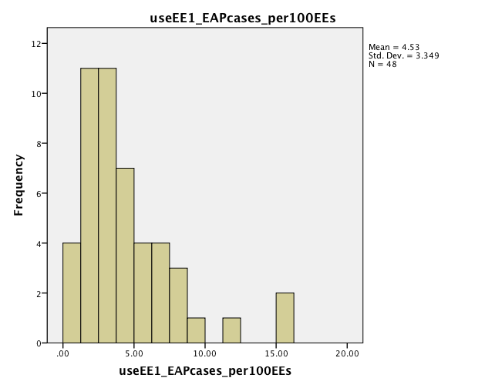
Utilization Rate 1: Variability in EAP Counselor Cases

Slide 64
Benchmark Utilization Rate for EAP Counselor Cases
Box is 100 Covered Employees
Use rate of 4.5%

Slide 65
Utilization Rate 2: EAP Counselor Sessions
This rate is calculated by dividing the total number of counseling sessions provided by the total number of covered employees and then multiplying this figure by 100.
Mean = 11.0
On average, there were 11.0EAP counseling sessions (units of service) delivered per year for every 100 covered employees.
Median = 7.9
Range = 0.1 – 44.9
(n = 43)

Slide 66
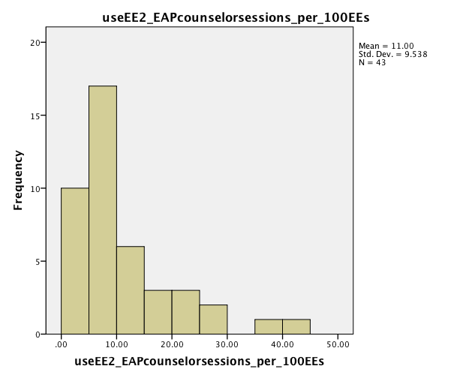
Utilization Rate 2: Variability in EAP Counselor Sessions

Slide 67
Utilization of Non-Counseling Services
EAP Organizational Services:
Management consultations
Crisis incident responses
Topic-specific trainings
Employee orientations
Supervisor training
Work-Life Services:
Youth and childcare
Adult and eldercare
Daily life concierge
Other work/life

Slide 68
EAP Organizational Services Mix
Management consultations (36%)
Topic-specific trainings (27%)
CISD/Crisis incident responses (16%)
Employee orientations on EAP (14%)
Supervisor training sessions (7%)
(%) = Each type as percentage of total of all organizational services provided within each vendor and these % then averaged across all vendors.
(n = 52)

Slide 69
Utilization Rate 3: EAP Organizational Services Rate
This rate is calculated by dividing the total number of all five kinds of EAP organizational services combined by the total number of covered employees and then multiplying this figure by 100.
Mean = 1.2
On average, there were 1.2 EAP organizational services delivered per year for every 100 covered employees.
Median = 0.3
Range = 0.1 – 21.3
(n = 48)

Slide 70
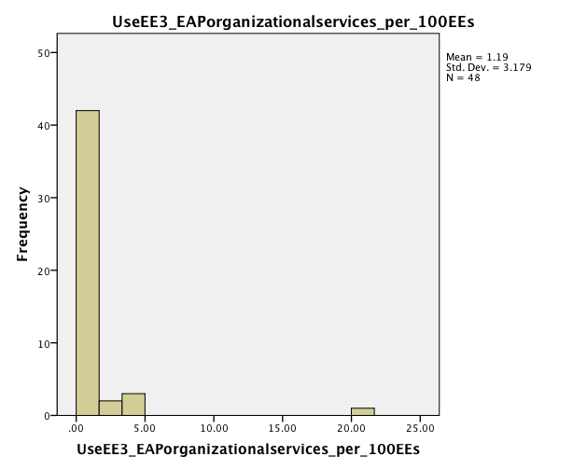
Utilization Rate 3: Variability in EAP Organizational Services

Slide 71
Utilization Rate 4: All EAP Services Rate
This rate is calculated by adding together the EAP counseling services rate and the EAP organizational services rate.
Mean = 12.0
On average, there were 12.0 EAP total services delivered per year for every 100 covered employees.
Median = 9.0
Range = 0.3 – 47.7
EAP Services Use Mix:
Counseling sessions = 91%
Organizational = 9%
(n = 38)

Slide 72
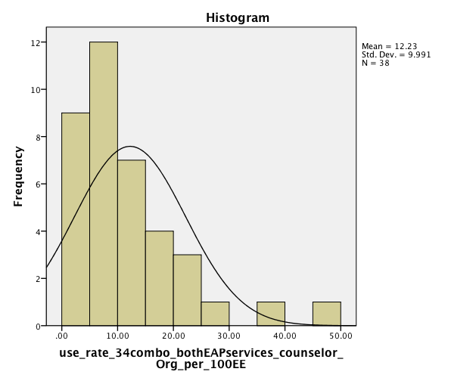
Utilization Rate 4: Variability in All EAP Services

Slide 73
Services Use Mix – EAP Counseling Sessions and EAP Organizational Services
(n = 38)

Slide 74
Work-Life Services Mix
Youth and childcare (28%)
Adult and eldercare (20%)
Convenience/personal concierge (14%)
Other work-life (37%)
(%) = Each type as percentage of total of all organizational services provided within each vendor and these % then averaged across all vendors.
(n = 37)

Slide 75
Utilization Rate 5: Work-Life Services Rate
This rate is calculated by dividing the total number of all four kinds of Work-Life services combined by the total number of covered employees and then multiplying this figure by 100.
Mean = 1.6
On average, there were 1.6 Work-Life services delivered per year for every 100 covered employees.
Median = 0.5
Range = 0.1 – 15.6
(n = 33)

Slide 76
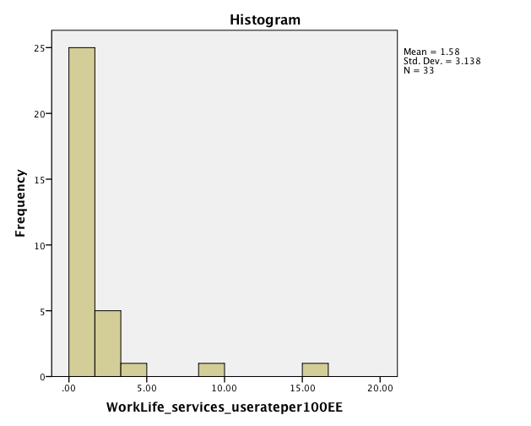
Utilization Rate 5: Variability in Work-Life Services

Slide 77
Utilization Rate 6: All EAP & Work-Life Services Rate
This rate is calculated by adding together the All EAP services rate and the Work-Life services rate.
Mean = 15.1
On average, there were 15.1 total services for EAP and Work-Life delivered per year for every 100 covered employees.
Median = 11.0
Range = 0.3 – 63.6
All Services Use Mix:
Counseling sessions = 79%
Organizational = 9%
Work-Life = 12%
(n = 28)

Slide 78
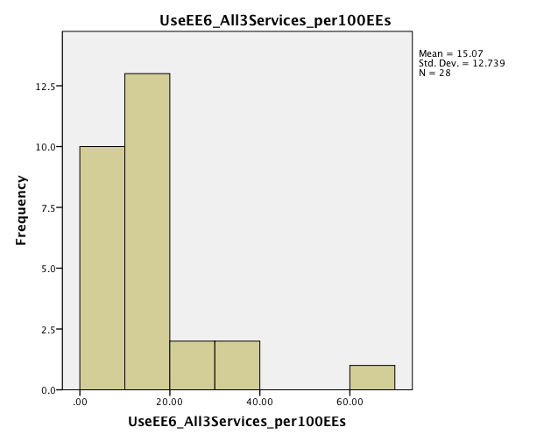
Utilization Rate 6: Variability in All EAP & Work/Life Services

Slide 79
Services Use Mix – All 3 Services
(n = 28)

Slide 80
Benchmark Utilization Rate for All Services Combined
Box is 100 Covered Employees
EAP Counselor
Sessions = 11.4%
EAP
Organizational
Services
= 1.2%
Work-Life
Services
= 1.6%

Slide 81
Utilization Rate Summary usage per 100 covered employees per year: Mean (statistical) Averages
(n = varies; rates not additive)

Slide 82
Utilization Rate Summary usage per 100 covered employees per year: Median (sample mid-point) Averages
(n = varies; rates not additive)

Slide 83
Covered LIVES Use Rates
Compared to utilization based on covered employees, findings are much lower when based on covered lives due to the number of total lives being roughly two and a half times greater than the number of total employees.
Therefore, when the above rates were calculated using the dominator of the population count of the number of total covered lives (employees and dependents)
instead of the population count of covered employees and the multiplier figured used at the end of the equation was 1,000 instead of 100.

Slide 84
Covered Lives Utilization Rate 1: EAP Counselor Cases
The Covered Lives CCR is calculated by dividing the total number of counselor cases by the total number of covered total lives (employees and dependents combined) and then multiplying this figure by 1000.
Mean = 19.4
On average, there were 19.4 people who had used the EAP for counseling per year per every 1,000 covered lives.
Median = 14.2
Range = 0.3 – 91.4
(n = 48)

Slide 85
Covered Lives Utilization Rate 2: EAP Counselor Sessions
This rate is calculated by dividing the total number of counseling sessions provided by the total number of covered total lives (employees and dependents combined) and then multiplying this figure by 1,000.
Mean = 47.7
On average, there were 47.7 EAP counseling sessions (units of service) delivered per year for every 1,000 covered lives.
Median = 33.5
Range = 0.3 – 263.7
(n = 43)

Slide 86
Covered Lives Utilization Rate 3: EAP Organizational Services Rate
This rate is calculated by dividing the total number of all five kinds of EAP organizational services combined by the covered total lives (employees and dependents combined) and then multiplying this figure by 1,000.
Mean = 5.0
On average, there were 5.0 EAP organizational services delivered per year for every 1,000 covered lives.
Median = 1.5
Range = 0.1 – 88.0
(n = 48)

Slide 87
Covered Lives Utilization Rate 4: All EAP Services Rate
This rate is calculated by adding together the Covered Lives EAP counseling services rate and the Covered Lives EAP organizational services rate.
Mean = 51.7
On average, there were 51.7 EAP total services delivered per year for every 1,000 covered lives.
Median = 36.9
Range = 0.4 – 91.5
(n = 38)

Slide 88
Covered Lives Utilization Rate 5: Work-Life Services Rate
This rate is calculated by dividing the total number of all four kinds of Work/Life services combined by the covered total lives (employees and dependents combined) and then multiplying this figure by 1,000.
Mean = 6.9
On average, there were 6.9 Work-Life services delivered per year for every 100 covered lives.
Median = 2.0
Range = 0.1 – 91.5
(n = 33)

Slide 89
Covered Lives Utilization Rate 6: All EAP & Work-Life Services Rate
This rate is calculated by adding together the Covered Lives All EAP services rate and the Covered Lives Work-Life services rate.
Mean = 65.4
On average, there were 65.4 total services for EAP and Work-Life delivered per year for every 100 covered lives.
Median = 43.2
Range = 0.1 – 372.3
(n = 28)

Slide 90
Results – Part 8 Survey Tools and Outcomes
RQ8. Surveys – How are follow-up surveys conducted at external EAP vendors and what are the average levels of user satisfaction and key outcomes?

Slide 91
Survey Activity: Sample Size
For your book of business during the 2011 year, how many users of your EAP participated in a survey that assessed their satisfaction with the service and other outcomes? For example, 2,000 surveys were completed either online, by phone or a hard copy.
2,255 mean 647 median
Range 4 – 26,580
(n = 59)

Slide 92
Survey Activity: Sample Size as Percentage of Counselor Cases
When divided into the mean number of EAP counselor cases, the mean number of surveys conducted represented 8% of the EAP users.
(m = 2,488 surveys divided by m = 30,139 EAP cases)
Thus, about 1 in every 12 users was surveyed.
(n = 45)

Slide 93
Use of Research-Validated Outcome Measurement Tools
On your follow-up surveys, did you incorporate items from a standardized and research-validated tool to measure outcomes after use of the EAP?
Less than half of
EAPs used validated
survey tools
(n = 62)

Slide 94
Validated Survey Measurement Tools
Of the 25 companies that used Validated Tools:
36% Other: mostly internally developed tools
28% Workplace Outcome Suite (WOS)
20% Stanford Presenteeism Scale
20% Health and Productivity Questionnaire (HPQ)
16% Work Limitations Questionnaire
4% Employer Measures of Productivity, Absence and Quality
(EMPAQ)
Variability in the number of different survey tools in use.

Slide 95
Survey Satisfaction & Outcome Items
Average percentage of EAP users surveyed who were satisfied with the EAP service overall.
Average percentage of EAP users surveyed who reported improvement due to counseling.
Average percentage of EAP users surveyed who reported improvement in work performance or productivity.
Average percentage of EAP users surveyed who reported improvement in work absence.

Slide 96
Levels of Satisfaction and Outcomes (% of Users Surveyed Book of Business)
Median = 96% 88% 75% 67%
Mean
(n = 50) (n = 45) (n = 39) (n = 28)

Slide 97
Mean Level of Satisfaction and Outcomes by Status of Use of Non-Use of Research-Validated Tools
(n = 50) (n = 45) (n = 39) (n = 28)

Slide 98
Range from Lowest to Highest in Mean Levels of Satisfaction and Outcomes (% of Users Surveyed)
80% - 100% 56% - 100% 30% - 97% 17% - 100%

Slide 99
Results – Part 9 Group Differences
RQ9. Group Differences – Do these benchmark measures differ appreciably between certain sub-groups of external EAP vendors?

Slide 100
Group Differences in Benchmarks: Exploratory Tests
By Market Size
By Country of HQ
By Dominant Pricing Model

Slide 101
Group Differences in Benchmarks: Smaller vs. Larger Size Markets
Two Groups Created from Initial Five:
Smaller Market Group = Local + Regional markets
n = 36 vendors (89% from US)
Larger Market Group = National + International + Global markets
n = 46 vendors (56% from US)
Results for 34 variables tested: 20 non-significant differences & 14 significantly different (at p < .10 level)

Slide 102
Group Differences in Benchmarks
(Based on Mean Averages): Smaller vs. Larger Size Markets
Larger Market Group GREATER THAN Smaller Market Group:
Total No. of client companies (customers)
671 > 191
Total No. of covered employees (population)
15 Million > 93k
Avg. No. of employees per client (contract size)
3,539 > 907
Total No. of staff dedicated to EAP (staff size)
215 > 16
Tax status of “for profit”
76% > 58%
Number of different primary services offered (services)
2.9 > 2.5
These four
results were
expected
due to size

Slide 103
Group Differences in Benchmarks
(Based on Mean Averages): Smaller vs. Larger Size Markets
Smaller Market Group GREATER THAN Larger Market Group:
Staffing ratio of the average number of EAP staff per every 10,000 covered employee lives (2.20 > 1.54)
% of all counseling sessions provided by EAP staff vs. by network affiliate counselors (54% staff > 34% staff)
EAP counselor case use rate (5.6% > 3.5%)
EAP counselor sessions use rate (14.6% > 8.5%)
Survey outcomes for overall improvement (91% > 83%), work performance (79% > 70%) and work absence (77% > 58%)
Based in US (89% > 56%)

Slide 104
Distribution of Vendors
Market Size X Country
MARKET: | United States | Canada | International
Local | 14 | 2 | 0
Regional | 18 | 1 | 1
National | 17 | 6 | 5
International | 3 | 1 | 2
Global | 6 | 2 | 4
Number of vendors listed in each cell in table.

Slide 105
Group Differences in Benchmarks
(Based on Mean Averages): Country
Three Groups Created from Location of HQ
United States Group n = 58 vendors
Canadian Group n = 12 vendors
International Group n = 12 vendors
Results for 37 variables tested: 30 non-significant differences & 7 significantly different (at p < .10 level)

Slide 106
Group Differences in Benchmarks
(Based on Mean Averages): Country
COA accredited program status (Canada highest)
CEAP status among EAP staff and affiliates (US highest)
Years in business (International lowest)
US 25 – CAN 27 – INT 18 years
Total No. of client companies (Canada highest)
US 376 – CAN 1,052 – INT 260
Avg. No. of counseling sessions per case (International lowest)
US 2.5 – CAN 3.1 – INT 1.7
Avg. % of counseling cases resolved in EAP without a referral for other services after use (Canada highest)
US 79% – CAN 90% – INT 85%

Slide 107
Dominant Pricing Model Groups in Total Sample
(n = 78)

Slide 108
Mix of Different Pricing Models Among All Contracts in Book of Business Year 2011
For Each Dominant Pricing Model Group
Capitated Pricing Model is Dominant (CAP)
(n = 61 vendors)
% of all contracts: Cap 85% - FFS 10% - FreeEAP 5%
Fee for Service Pricing Model is Dominant (FFS)
(n = 10 vendors)
% of all contracts: Cap 24% - FFS 75% - FreeEAP 1%
Embedded Fee Pricing Model is Dominant (FreeEAP)
(n = 7 vendors)
% of all contracts: Cap 11% - FFS 11% - FreeEAP 78%

Slide 109
Tests of Group Differences in Benchmarks
(Based on Mean Averages): Dominant Pricing Model
GROUPS DIFFERENT
Avg. No. covered employees per contract
CAP 2,362 – FFS 927 – FreeEAP 6,918
Avg. No. Covered employees per 1 EAP Staff
CAP 10.5k – FFS 12.1k – FreeEAP 39.8k
EAP case use rate
CAP 4.7% – FFS 6.0% – FreeEAP 1.6%
EAP organizational services use rate
CAP 1.4% – FFS 1.1% – FreeEAP 0.2%

Slide 110
Test of Group Differences in Benchmarks
(Based on Mean Averages): Dominant Pricing Model
GROUPS SIMILAR
Avg. No. counselor sessions per case
CAP 2.4 – FFS 2.7 – FreeEAP 3.1
Avg. % counselor sessions by EAP staff
CAP 44% – FFS 34% – FreeEAP 42%

Slide 111
Results - Part10 Business Management
RQ10. Business Management Practices – How often are key business practices used at external EAP vendors (e.g., promotional practices, managing internal operational objectives, client focused activities and operational objectives)?

Slide 112
Business Management: Promotional Practices
Question on the Survey:
For the items below, please rate rate how frequently your clients noted each of the marketing sources below as a way that they had became aware of the EAP service:
9 Factors.
Rated on 5-point Scale – very low to very high frequency.

Slide 113
EAP Promotional Practices
(n = 60-68)

Slide 114
Business Management: Difficulty with Objectives with Client Company Focus
Question on the Survey:
For the items below, please rate the level of “difficulty” for managing these objectives in the 2011 year. Difficulty is defined as high expense and or high time commitment by the EAP.
11 Factors.
Rated on 5-point Scale – very low difficulty to very high difficulty.

Slide 115
Areas of Client Company Focus Difficulty
(n = 67-69; *47)

Slide 116
Business Management: Difficulty with Objectives for Internal Operations
Question on the Survey:
For the items below, please rate the level of “difficulty” for managing these objectives in the 2011 year. Difficulty is defined as high expense and or high time commitment by the EAP.
7 Factors.
Rated on 5-point Scale – very low difficulty to very high difficulty.

Slide 117
Areas of Internal Operations Difficulty
(n = 77-79; * = 53)

Slide 118
Results – Part 11 Business Development
RQ11. Business Development – Which factors are perceived to have had the most impact on retaining current customers and new sales and also on lost business at external EAP vendors?

Slide 119
Business Development: Client Renewal & New Contracts
Question on the Survey:
This item requests your opinion. Please rate each factor listed below according to its’ impact on contract renewals and new contracts for EAP services at your company in the 2011 year.
11 Factors.
Rated on 5-point Scale – very low importance to very high importance.

Slide 120
Factors Impacting Client Renewal and New Sales
(n = 69)

Slide 121
Business Erosion: Clients Lost
Question on the Survey:
This item requests your opinion. Please rate each factor below for how important it was as a primary, not a secondary, source of why customers did not renew their contracts for EAP services in the 2011 year.
8 Factors.
Rated on 5-point Scale – very low importance to very high importance.

Slide 122
Factors Impacting Client Erosion
(n = 69)

Slide 123
Results – Part 12 The Future
RQ12. Future of the Field – How optimistic (or pessimistic) are external EAP vendors about the future of the field and why?

Slide 124
Seeing the Future Survey Question: What is your level of optimism about the future of the external EAP industry?

Slide 125
Forecasting the Future of EAP Field
(n = 69)

Slide 126
Future: Qualitative Comments Theme 1- Low Prices
The main concern is [too low] pricing schemes. {Global}
As a local / regional EAP provider, we are loosing too many accounts to "Free" EAP's. {Local}
EAP is getting more and more embedded in the Insurance Plans for most national companies. {Local}
Brokers/consultants are pushing rates to levels that are unrealistic based on customer demands and quality. Product continues to be compromised due to steady rate [product price] decreases. At some point we as an industry need to join forces to challenge this downward spiral. {National}
Our fees are diminished to the extent that brokers won't talk to EAP's because there is nothing in it for them financially. {Local}
External EAP's in Canada are an accepted and expected part of an organization's benefit plan. The challenge is around the commoditization of EAP. {National}

Slide 127
Future: Qualitative Comments Theme 2 – Integration and Workplace
EAP core services are in a mature market. Thus, peripheral services – CIR [crisis intervention response], SAP [substance abuse program], Work/Life, and Wellness – provide room for growth. {National}
If EAP's can expand their role into the psychosocial aspect of behavior change relative to physical health related behavior change. {National}
EAP is well known and well embedded in the workplace. EAPs have also expanded their offerings to include Work/Life, mediation, ID theft, etc. in order to maintain high visibility. {Global}
Productivity will always be important to American businesses and is becoming increasingly important to global competition. As US health care reform is worked out and the US emerges from the current economic downturn, employer benefit and HR professionals will focus more of their attention on these issues. {National}
I am optimistic about the EAP field, if EAPs focus on behavioral risk management and productivity. {Local}

Slide 128
Future: Qualitative Comments Theme 3 – Adaptation to Trends
We need to adapt our skills to the changing needs of the workforce and employers. {Regional}
EAPs simply need to redefine/reenergize their value propositions and speak genuinely and truthfully to the value of EAP programming. {Regional}
Fewer regional competitors combined with the growth of the wellness industry has created further opportunities for differentiation and increased interest in hands-on behavioral health services. {Regional}
Technology will facilitate more conversations and can support therapists in reaching clients wherever they are and whenever they want. As service modalities expand and the reach into digital lengthens, EAPs have great potential to grow their role as trusted experts and to increase the mental health support they offer to their clients. {National}

Slide 129
Part 3 Themes in Findings

Slide 130
Themes in Study Findings
Largest study done to date of External EAPs representing 82 providers and 164M covered lives.
Diversity in types of corporate structure of these businesses (size/market, ownership, tax status).
Most EAPs also now offer Work/Life and Wellness.
1 in 3 involved in recent company merger or acquisition.
Few vendors have COA accredited programs (13%)
CEAP almost entirely for US and twice as likely for staff counselors than for affiliate counselors.
1 in 4 contracts have EAPs as “gatekeeper” role for gaining access to mental health benefits.
Continuation after EAP counseling allowed in about half of contracts.

Slide 131
Themes in Study Findings
Capitation pricing is most common, but most also offer Fee for Service pricing option.
HR is most common point of client contact.
9 of 10 EAPs conduct follow-up surveys on large samples of users (about 1 in every 12 EAP cases gets surveyed), but less than half of vendors use research-validated tools in their surveys.
Survey data shows that end user satisfaction is very high and large majority of users report positive outcomes personally and improvements at work.

Slide 132
Themes in Study Findings
Utilization of EAP services varies considerably across vendors and types of services
In general, wide variability almost all benchmarks
Some differences by market size, with smaller market EAPs higher in counseling staff ratio, use rates for EAP counseling cases and organizational services and better survey outcomes
Few differences by country
Exploratory difference by pricing models

Slide 133
Themes in Study Findings
EAPs have difficulty in several areas of internal operations and client focus engagement efforts.
Price (low price) is major driver of both new sales and loss of business – more so than product features and quality.
And Yet…
8 in 10 are optimistic about the future of EAP field.

